Slide 1
Replicated Data Storage A totally ordered multicast based solution

Slide 2
THE PROBLEM
Distributed data storage
Multiple unknown servers
Same LAN
Sequential consistency
Read & Write primitives

Slide 3

Distributed data storage
The software architecture emulates the presence of a DB by using a HashTable to save the data in the tuple format < id, value >.
Both the id and the value are integer numbers and can be written or read using the corresponding primitives. Each server owns a private, consistent copy of the dataset.

Slide 4
Multiple unknown servers
The servers’ number can scale indefinitely and servers are discovered dynamically.
Each server has a thread used to multicast hello messages every X seconds and a second thread that receives such messages, collects the IPs of the senders and makes available to the current server the size of the group in a certain time window

Slide 5
Same LAN
All the messages are exchanged on the same LAN using:
multicast messages on the multicast group 224.0.5.1
point to point messages between threads

Slide 6
Sequential consistency
The distributed data set is granted to be consistent due to the implementation of a sequential consistency model.
Such a model is achieved by means of a totally ordered multicast primitive

Slide 7
Read & Write primitives
Client requests can be writes (int id, int value) or reads (int id).
Writes are performed in perallel across all the servers while reads only happpen locally and are processed by the server the client connects to

Slide 8
The model

Slide 9
The software architecture makes use of active replication to keep the consistency among the servers’ datasets

Slide 10
Writes are submitted to the server the client connects to. Then, such server multicasts the message on the LAN to the other members of the group

Slide 11
Reads are performed locally and directly by the server the client has submitted the request to

Slide 12
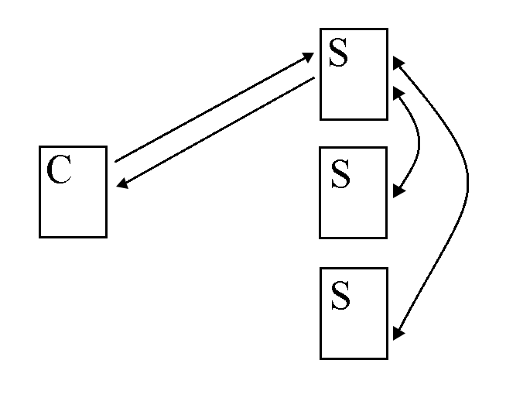

Slide 13
Totally ordered multicast

Slide 14
Every message that reaches the server is signed with a unique scalar clock from the local machine, is added to the local queue (sorted) and then is multicasted.

Slide 15
Every server receiving the multicasted message adds it to the local queue (sorted) and sends an ack still in multicast. Once a server has the acks from all the participants, it executes the message

Slide 16
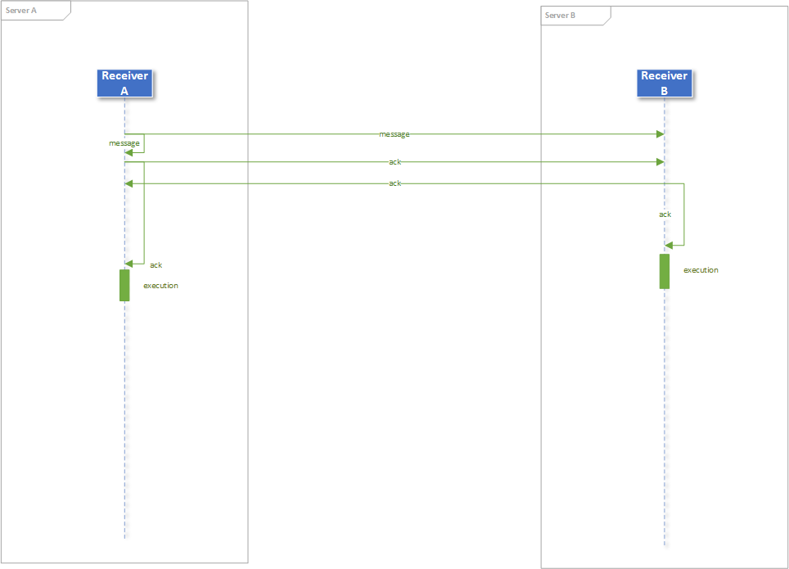

Slide 17
The architecture

Slide 18
The server architecture is made of 9 components:
Server: accepts client connections and assigns scalar clocks
Handler: handles the messages from the client

Slide 19
DeliveryService: ensures the delivery of every single message
Unchoker: avoids stalls caused by lost messages towards the Receiver
Receiver: it’s the main component and includes the main logic
SharedContent: allows to share data between different threads

Slide 20
StorageUpdater: updates the content of the local dataset once a server becomes active
AlivenessSender: sends the hello messages every X seconds
AlivenessChecker: collects the active servers in a certain time window

Slide 21
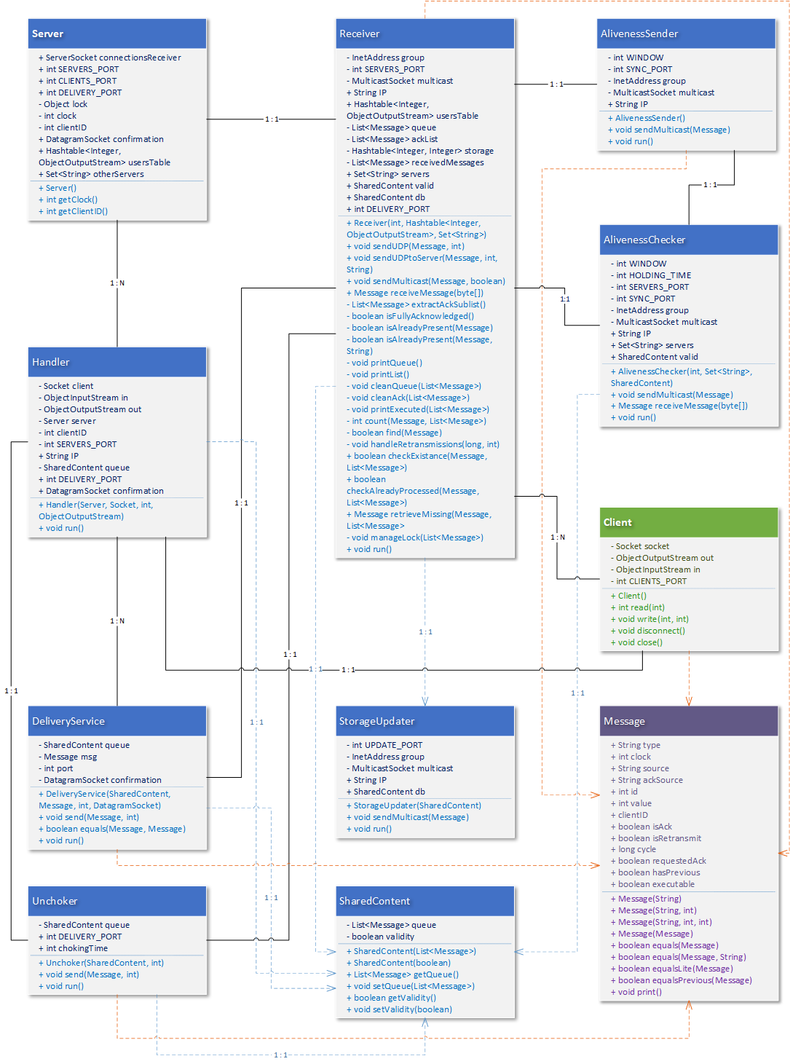

Slide 22
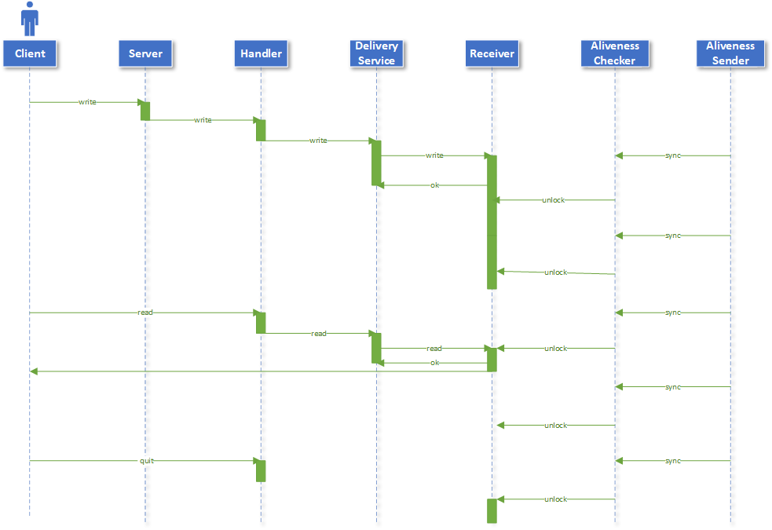

Slide 23
Thanks!
Any questions?

Slide 24


